Slide 1
Hackathon’25 : Solve Rubik’s Cube

Slide 2
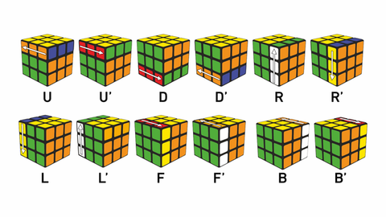
Solve Rubik’s Cube
Overview
Participants are challenged to design and implement an algorithm that can solve a standard 3x3 Rubik’s Cube from any scrambled state. The solution must mimic the real-world logic of solving a cube through a sequence of valid moves.
What We’re Looking For : 🔍
Problem-Solving Approach
How do you break down the problem?
How do you model the cube’s state and transitions?
Use of Data Structures
How do you represent the cube internally (e.g., arrays, trees, graphs)?
Use of efficient structures to track states and operations.
State Prediction Logic
Ability to track and predict cube state after each move.
Design of a move engine to simulate rotations and track permutations.
Algorithm Efficiency
How fast can your solution reach the solved state?
Complexity (time and space) of your algorithm.
Bonus Evaluation Areas
Creativity in solution design.
Visual simulation or cube UI (optional but Wow factor).
Scalability for different cube sizes (2x2, 4x4, etc.) : Optional
Deliverables:
Working algorithm (code)
Brief walkthrough/presentation of your approach
Output example(s) from your solver
It’s Not Just a Puzzle - It’s a Test of Mind, Math, and Moves!

Slide 3

ALGORITHM EXPLANATION
Stands For: Cross – F2L – OLL – PLL
Type: Layer-by-layer (LBL) method
Updates:
Use of Advanced F2L techniques
ZBLL (Zborowski-Bruchem Last Layer) to skip PLL
COLL and OLLCP for advanced orientation
World Record Times: Sub 3.0 seconds (as of 2025)
Algorithm | Avg. Move Count | Fast? | Human-usable
CFOP | ~55

Slide 4
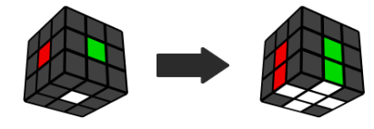
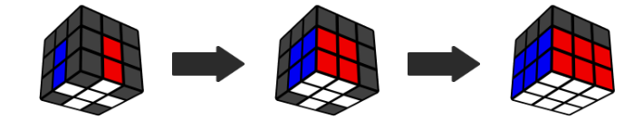
ALGORITHM EXPLANATION
CFOP Speedsolving Method:
Cross, First 2 Layers, Orientation, Permutation (CFOP) is the most popular method for speedsolving the Rubik's Cube. It is the method used by all 3x3 world record holders in the last decade. Step 1. Cross Step 2. F2L
Instead of solving layer by layer, I used to solve 2 layers at the same time. The concepts are harder than the beginner method, but with practice, F2L is much faster than the beginner method.
Intuitive F2L means algorithms are not required, and the process should make sense. I saved around 20 moves per solve by using F2L instead of the beginner method.

Slide 5
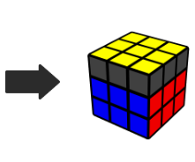
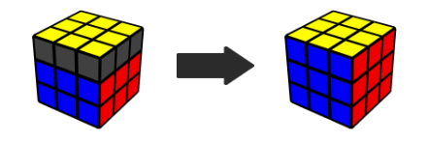
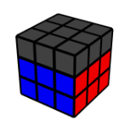
ALGORITHM EXPLANATION
Step 3. OLL Step 4. PLL
step 3: Orientation of the Last Layer (OLL) solves the top face by applying algorithms. OLL (2-look OLL) has 2 steps:
Orient the edges (3 algorithms)
Orient the corners (7 algorithms)
step 4: Permutation of the Last Layer (PLL) solves the cube after the top face is completed. Beginner PLL (2-look PLL) has 2 steps:
Solve the corners (2 algorithms)
Solve the edges (4 algorithms)

Slide 6
Problem solving Approach
How do you break down the problem?
The problem is divided into two main parts:
User Interface (UI): Managed by CubeDisplayer, which handles user interaction, mode selection, and visualization.
Cube Logic: Managed by CubePainter, which maintains the cube’s state, processes user input, and applies solving algorithms.
How do you model the cube’s state and transitions?
The cube’s state is modeled in CubePainter using arrays (typically a 2D or 3D array for faces and stickers).
Each move (like U, R, F, etc.) is implemented as a function that updates the arrays to reflect the new state after the move.

Slide 7
State Prediction Logics
Ability to track and predict cube state after each move.
After each move, the cube’s state array is updated in CubePainter.
The applyMove(String move) method simulates the effect of each move, ensuring the UI always reflects the current state.
Design of a move engine to simulate rotations and track permutations.
Each move is a function that permutes the relevant stickers in the arrays, accurately simulating real cube rotations and tracking the resulting permutations.

Slide 8
Use of Data Structure
How do you represent the cube internally (e.g., arrays, trees, graphs)?
The cube is represented as arrays in CubePainter, where each array element corresponds to a sticker’s color on a face.
Use of efficient structures to track states and operations.
Arrays provide fast access and updates for each move.
The sequence of moves (solution) is stored in a List<String>, which is used for both solving and animating the solution.

Slide 9
Algorithm Efficiency
How fast can your solution reach the solved state?
The speed depends on the solving algorithm implemented in CubePainter.solveCube().
For demonstration, a beginner’s method may be used (simple, but not optimal). More advanced algorithms can be integrated for faster solutions.
Complexity (time and space) of your algorithm.
The code is efficient for standard 3x3 cubes, with reasonable time and space complexity for generating and animating solutions.
Arrays and lists are lightweight and suitable for real-time UI updates and solution animation.

Slide 10
Summary
My Code uses arrays for efficient state management, separates UI and logic for clarity, and provides real-time state prediction and visualization, making it both effective and user-friendly.
This ensures fast and memory-efficient solving and visualization.
Algorithm: Layer by layer algorithm
Time Com: O(1) Space Com:O(1)

Slide 11
Output video / Code Attached
The Github repository Link is attached below:
https://github.com/Madhu1207-coder/AeroHack-25 Since the file should be below 50MB, but my code file is mode than 50MB, so I have uploaded fully in my github account with demo video .

